Slide 1
Pandas (Python Module) Seyyed Ali Shohadaalhosseini

Slide 2
Introduction
What is Pandas?
Pandas is a Python library used for working with data sets.
It has functions for analyzing, cleaning, exploring, and manipulating data.
The name "Pandas" has a reference to both "Panel Data", and "Python Data Analysis" and was created by Wes McKinney in 2008.

Slide 3
Why Use Pandas?
Pandas allows us to analyze big data and make conclusions based on statistical theories.
Pandas can clean messy data sets, and make them readable and relevant.
Relevant data is very important in data science.
Data Science: is a branch of computer science where we study how to store, use and analyze data for deriving information from it.

Slide 4
What Can Pandas Do?
Pandas gives you answers about the data. Like:
Is there a correlation between two or more columns?
What is average value?
Max value?
Min value?
Pandas are also able to delete rows that are not relevant, or contains wrong values, like empty or NULL values. This is called cleaning the data.

Slide 5
Where is the Pandas Codebase?
The source code for Pandas is located at this GitHub repository https://github.com/pandas-dev/pandas

Slide 6
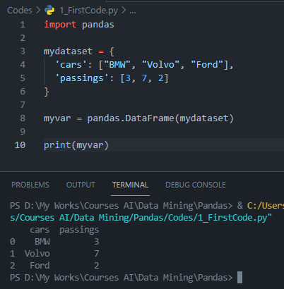

Let’s get into coding
Look at the front example:
alias: In Python alias are an alternate name for referring to the same thing.
Now the Pandas package can be referred to as pd instead of pandas.
The version string is stored under __version__ attribute, So

Slide 7
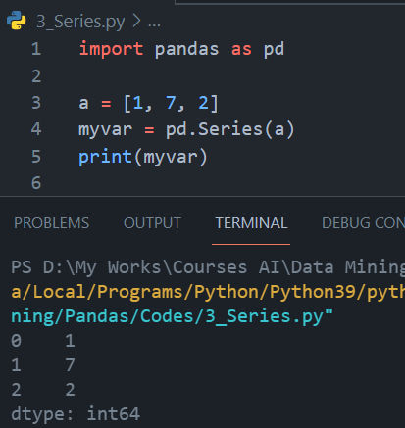
Pandas Series
What is a Series?
A Pandas Series is like a column in a table. It is a one-dimensional array holding data of any type.

Slide 8
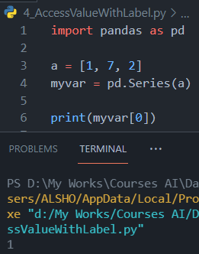
Pandas Series
Labels
If nothing else is specified, the values are labeled with their index number. First value has index 0, second value has index 1 etc. This label can be used to access a specified value.

Slide 9
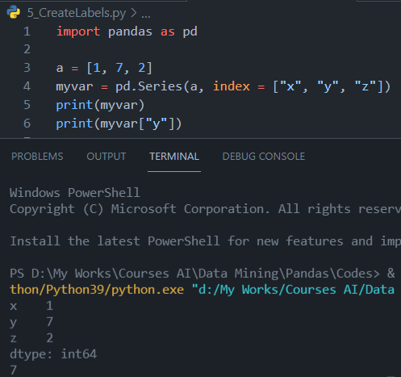
Pandas Series
Create Labels
With the index argument, you can name your own labels. When you have created labels, you can access an item by referring to the label.

Slide 10
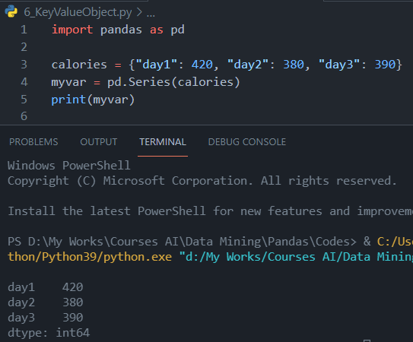
Pandas Series
Key/Value Objects as Series
You can also use a key/value object, like a dictionary, when creating a Series.
The keys of the dictionary become the labels.

Slide 11
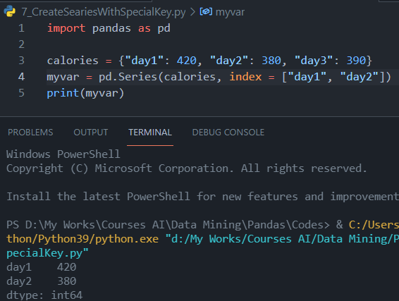
Pandas Series
Key/Value Objects as Series
To select only some of the items in the dictionary, use the index argument and specify only the items you want to include in the Series.

Slide 12
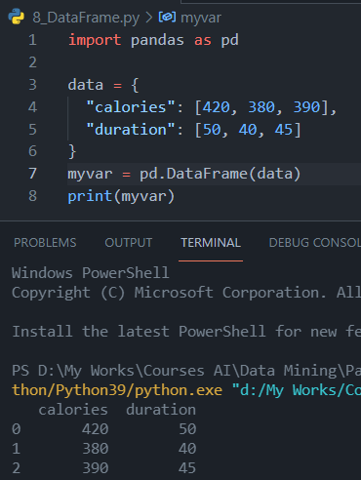
Pandas Series
DataFrames
Data sets in Pandas are usually multi-dimensional tables, called DataFrames. Series is like a column, a DataFrame is the whole table.
What is a DataFrame?
A Pandas DataFrame is a 2 dimensional data structure, like a 2 dimensional array, or a table with rows and columns.

Slide 13
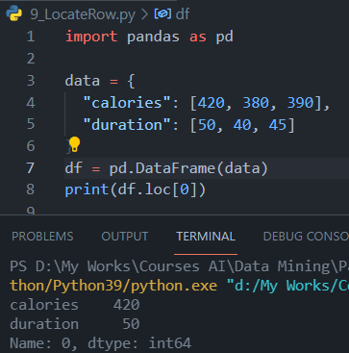
Pandas DataFrames
Locate Row
As you can see from the result above, the DataFrame is like a table with rows and columns. Pandas use the loc attribute to return one or more specified row(s).
Note: This example returns a Pandas Series.
loc[:] helps to access a group of rows and columns in a dataset, a slice of the dataset, as per our requirement. For instance, if we only want the last 2 rows and the first 3 columns of a dataset, we can access them with the help of loc[:]. We can also access rows and columns based on labels instead of row and column number.
iloc[:] works in a similar manner, just that iloc[:] is not inclusive on both values. So iloc[0:4] would return rows with index 0, 1, 2, and 3, while loc[0:4] would return rows with index 0, 1, 2, 3, and 4. The documentation for iloc[:] can be found here.

Slide 14
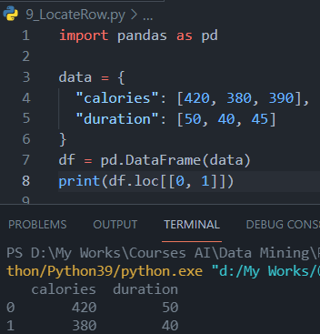
Pandas DataFrames
Note: When using [ ], the result is a Pandas DataFrame.

Slide 15
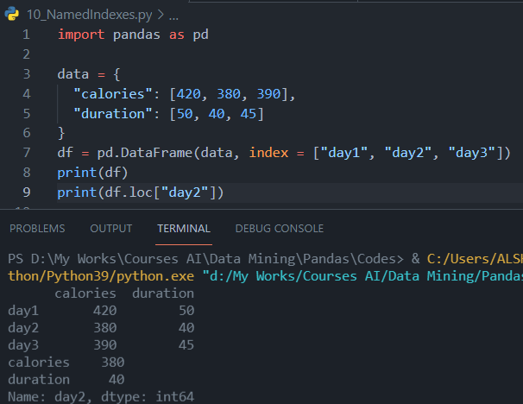
Pandas DataFrames
Named Indexes
With the index argument, you can name your own indexes.
Example
Add a list of names to give each row a name:
NOTE: Use the named index in the loc attribute to return the specified row(s).

Slide 16
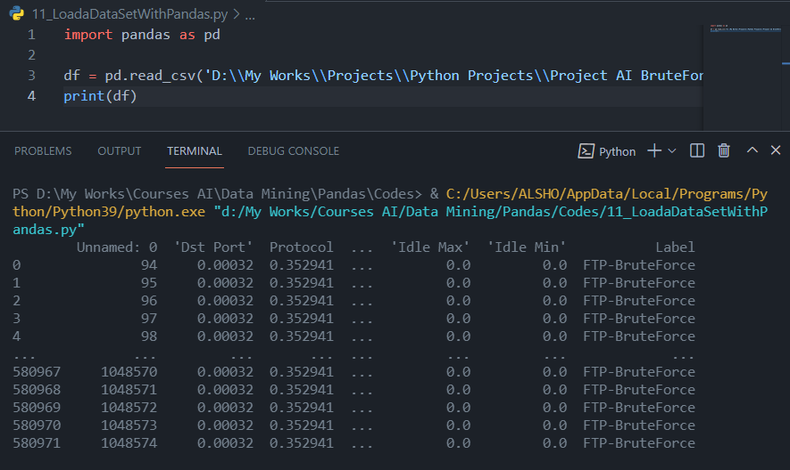
Pandas DataFrames
Load Files Into a DataFrame
If your data sets are stored in a file, Pandas can load them into a DataFrame with read_csv() method.
Example
In our example we are importing BrutForce.csv. Load a comma separated file (CSV file) into a DataFrame:

Slide 17
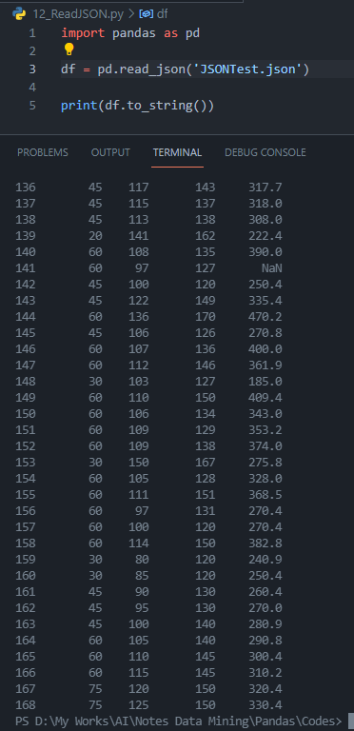
Pandas Read JSON
Big data sets are often stored, or extracted as JSON.
JSON is plain text, but has the format of an object, and is well known in the world of programming, including Pandas.
In our examples we will be using a JSON file called ‘JSONTest.json'.
Note: use to_string() to print the entire DataFrame.

Slide 18
JSON
JSON = Python Dictionary ☺
JSON objects have the same format as Python dictionaries, So If your JSON code is not in a file, but in a Python Dictionary, you can load it into a DataFrame directly:

Slide 19
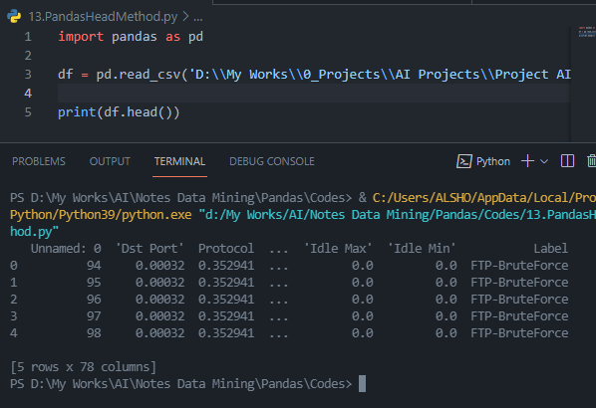
Pandas - Analyzing
Viewing the Data
head(n)
One of the most used method for getting a quick overview of the DataFrame, is the head() method. The head(n) method returns the headers and a specified n number of rows, starting from the top.
Note: if the number of rows is not specified, the head() method will return the top 5 rows.
tail()
There is also a tail() method for viewing the last rows of the DataFrame. The tail() method returns the headers and a specified number of rows, starting from the bottom.

Slide 20
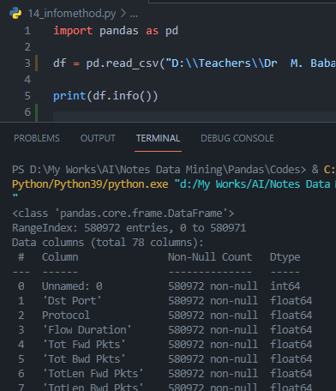
Pandas - Analyzing
info()
The DataFrames object has a method called info(), that gives you more information about the data set.

Slide 21
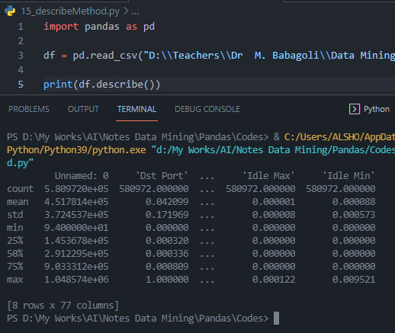
Pandas - Analyzing
describe()
describe() is used to generate descriptive statistics of the data in a Pandas DataFrame or Series. It summarizes central tendency and dispersion of the dataset. describe() helps in getting a quick overview of the dataset. More details about describe() can be found here.
describe() lists out different descriptive statistical measures for all numerical columns in our dataset. By assigning the include attribute the value ‘all’, we can get the description to include all columns, including those containing categorical information.

Slide 22
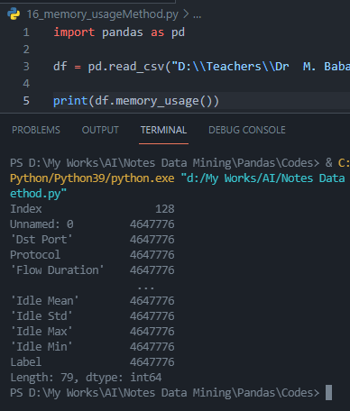
Pandas - Analyzing
memory_usage()
memory_usage() returns a Pandas Series having the memory usage of each column (in bytes) in a Pandas DataFrame. By specifying the deep attribute as True, we can get to know the actual space being taken by each column. More details on memory_usage() can be found here.
The memory usage of each column has been given as output in a Pandas Series. It is important to know the memory usage of a DataFrame, so that you can tackle errors like MemoryError in Python.

Slide 23
Pandas - Analyzing
astype()
astype() is used to cast a Python object to a particular data type. It can be a very helpful function in case your data is not stored in the correct format (data type). For instance, if floating point numbers have somehow been misinterpreted by Python as strings, you can convert them back to floating point numbers with astype(). Or if you want to convert an object datatype to category, you can use astype().

Slide 24
Pandas - Analyzing
value_counts() returns a Pandas Series containing the counts of unique values. Consider a dataset that contains customer information about 5,000 customers of a company. value_counts() will help us in identifying the number of occurrences of each unique value in a Series. It can be applied to columns containing data like State, Industry of employment, or age of customers.

Slide 37
Continue here https://www.w3schools.com/python/pandas/pandas_cleaning.asp

Slide 39
Resources
W3Schools

